Slide 1
PWA workshop
Part 1
App Manifest and Service Worker
Notes:
https://the-guide.github.io/fe-guild-2019-pwa-code-labs/

Slide 2
Understanding the
App Manifest

Slide 3
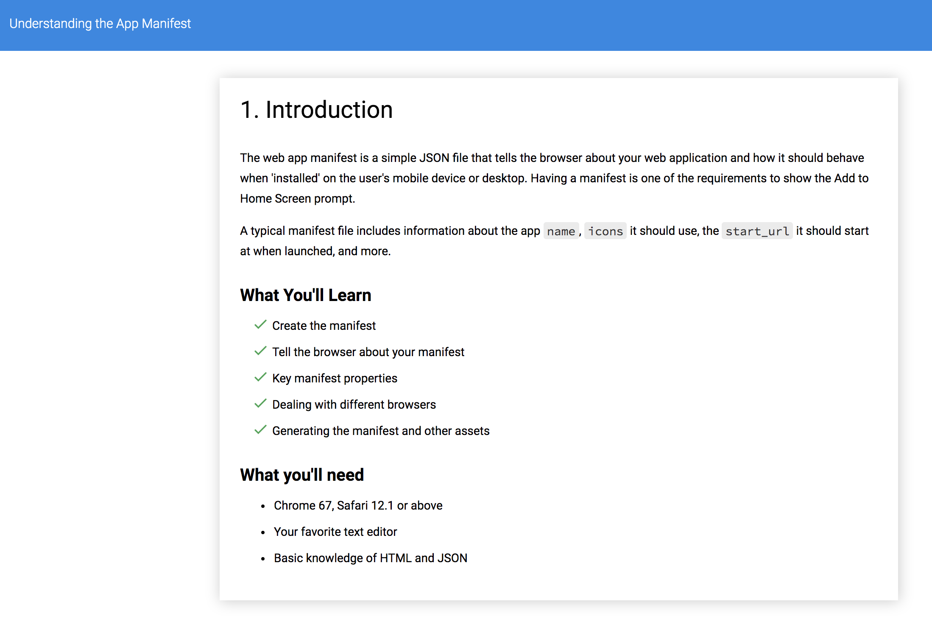

Slide 4
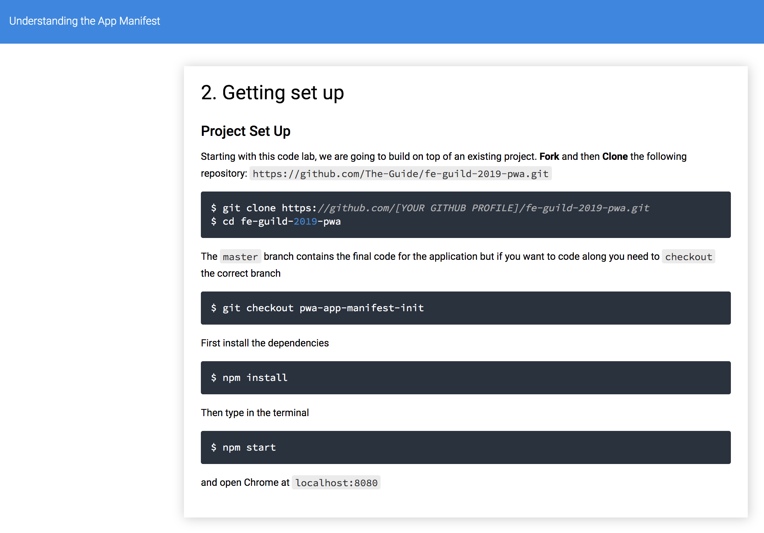

Slide 5
3. Create the Manifest
Create a manifest.json file in the same folder as index.html. A minimal manifest.json file for a progressive web app.
{
"name": "Progressive Selfies",
"short_name": "PWA Selfies",
"icons": [
{
"src": "/src/images/icons/app-icon-192x192.png",
"type": "image/png",
"sizes": "192x192"
},
{
"src": "/src/images/icons/app-icon-512x512.png",
"type": "image/png",
"sizes": "512x512"
}
],
"start_url": "/index.html",
"scope": ".",
"display": "standalone",
"background_color": "#fff",
"theme_color": "#3f51b5"
}
Tell the browser about your manifest
When you have created the manifest, add a link tag to all the pages that encompass your web app. Add it to your index.html
<link rel="manifest" href="/manifest.json">

Slide 6
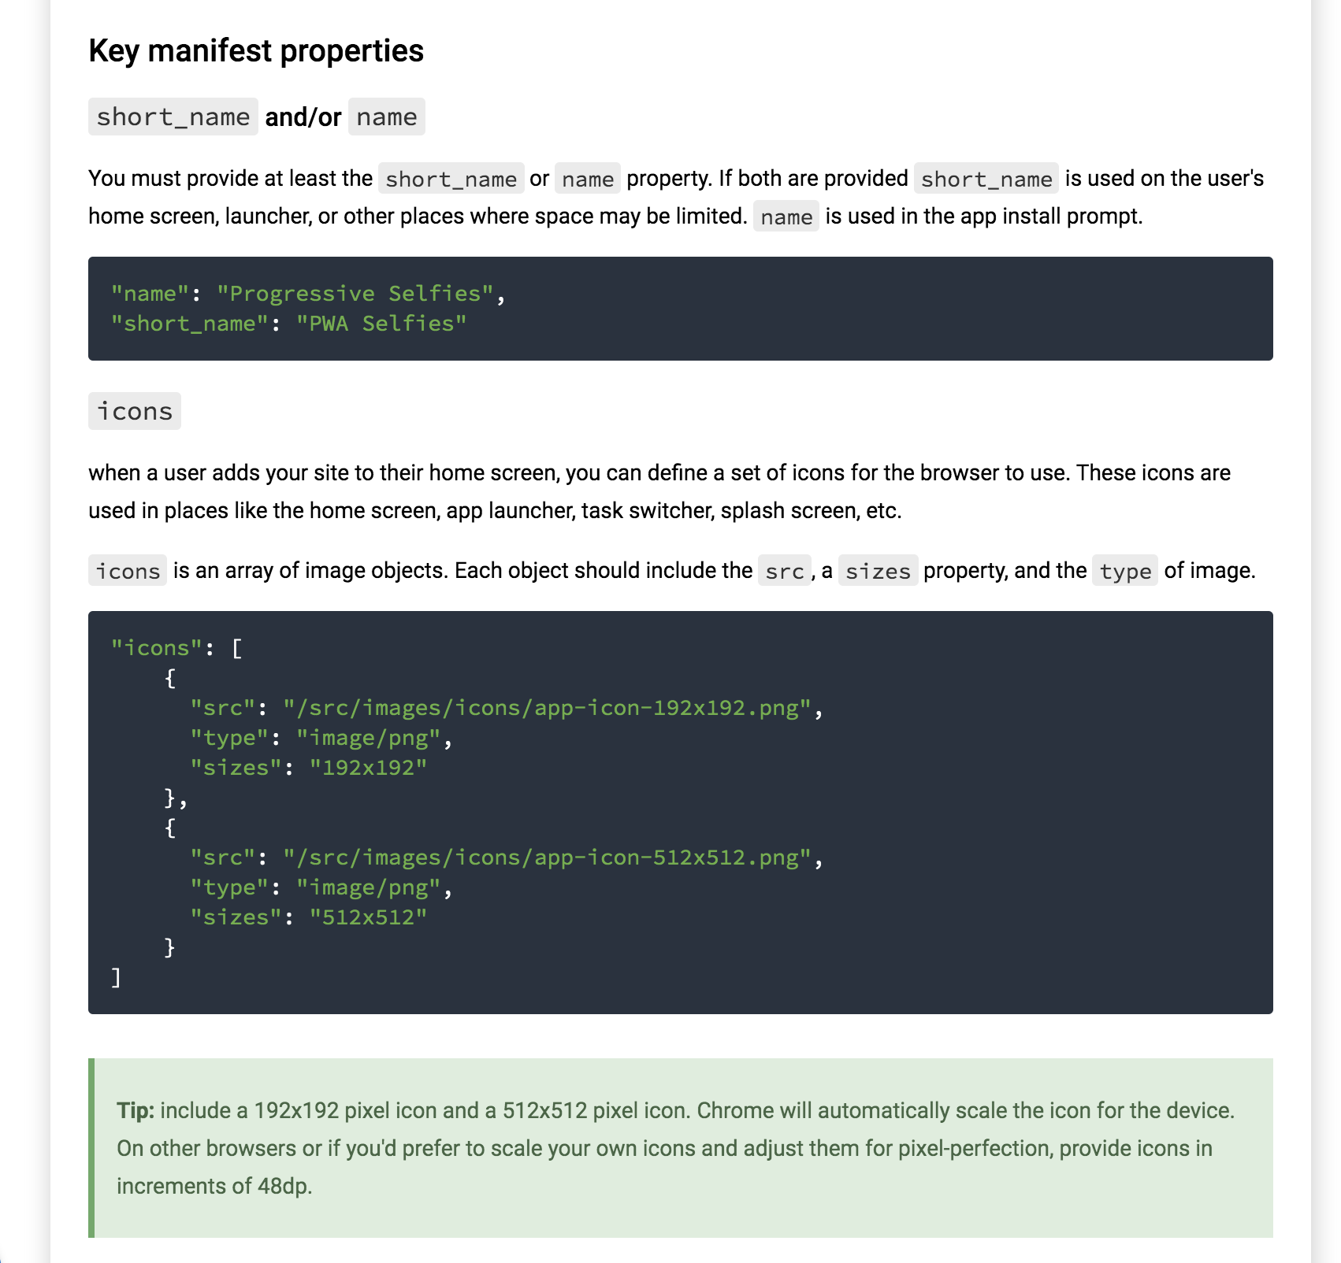

Slide 7
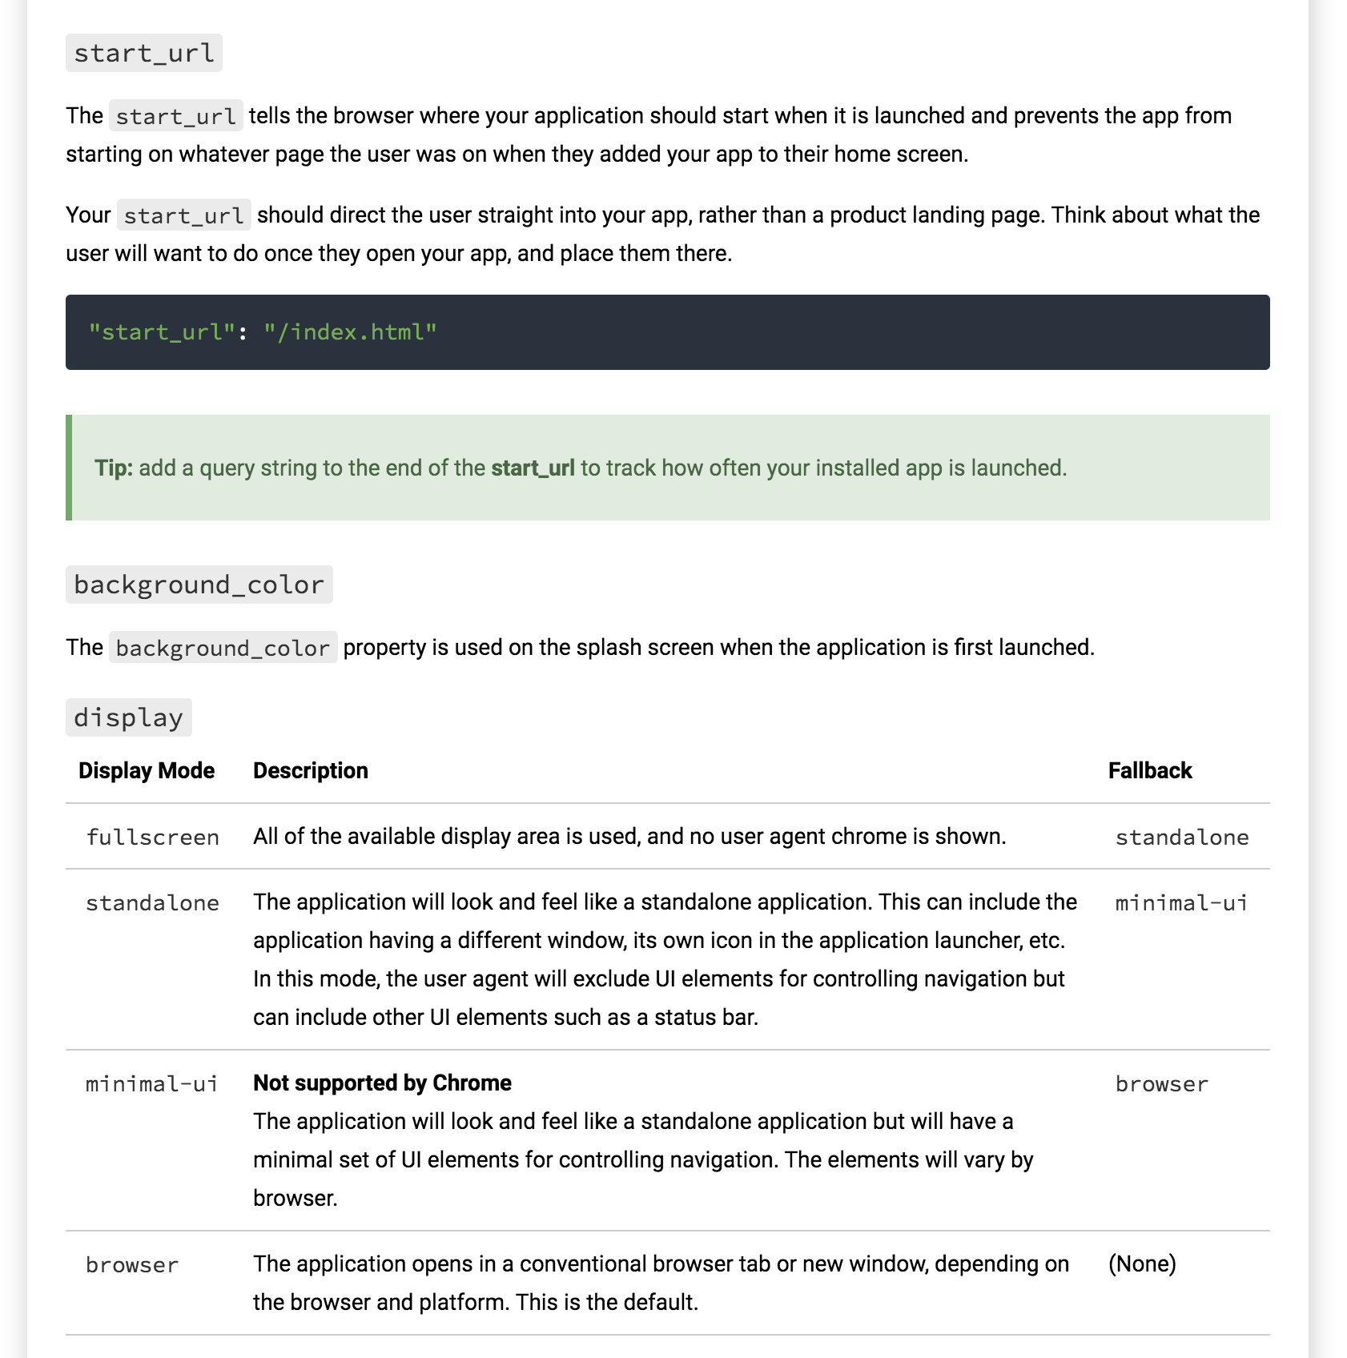

Slide 8
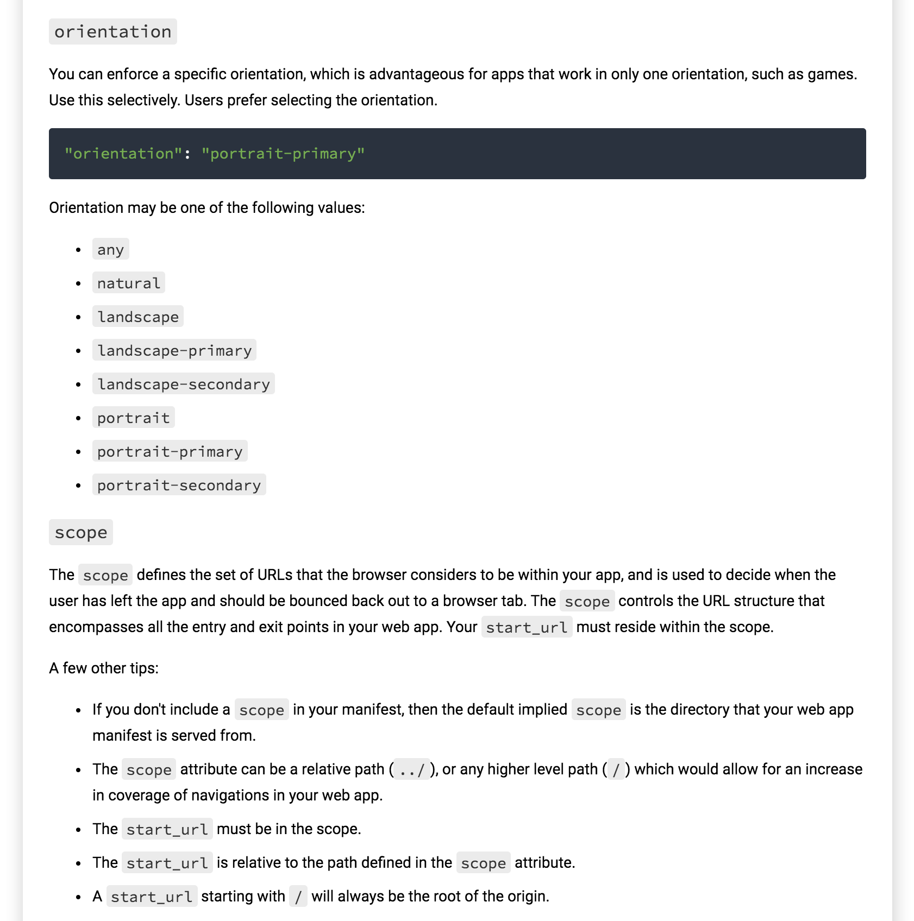

Slide 9
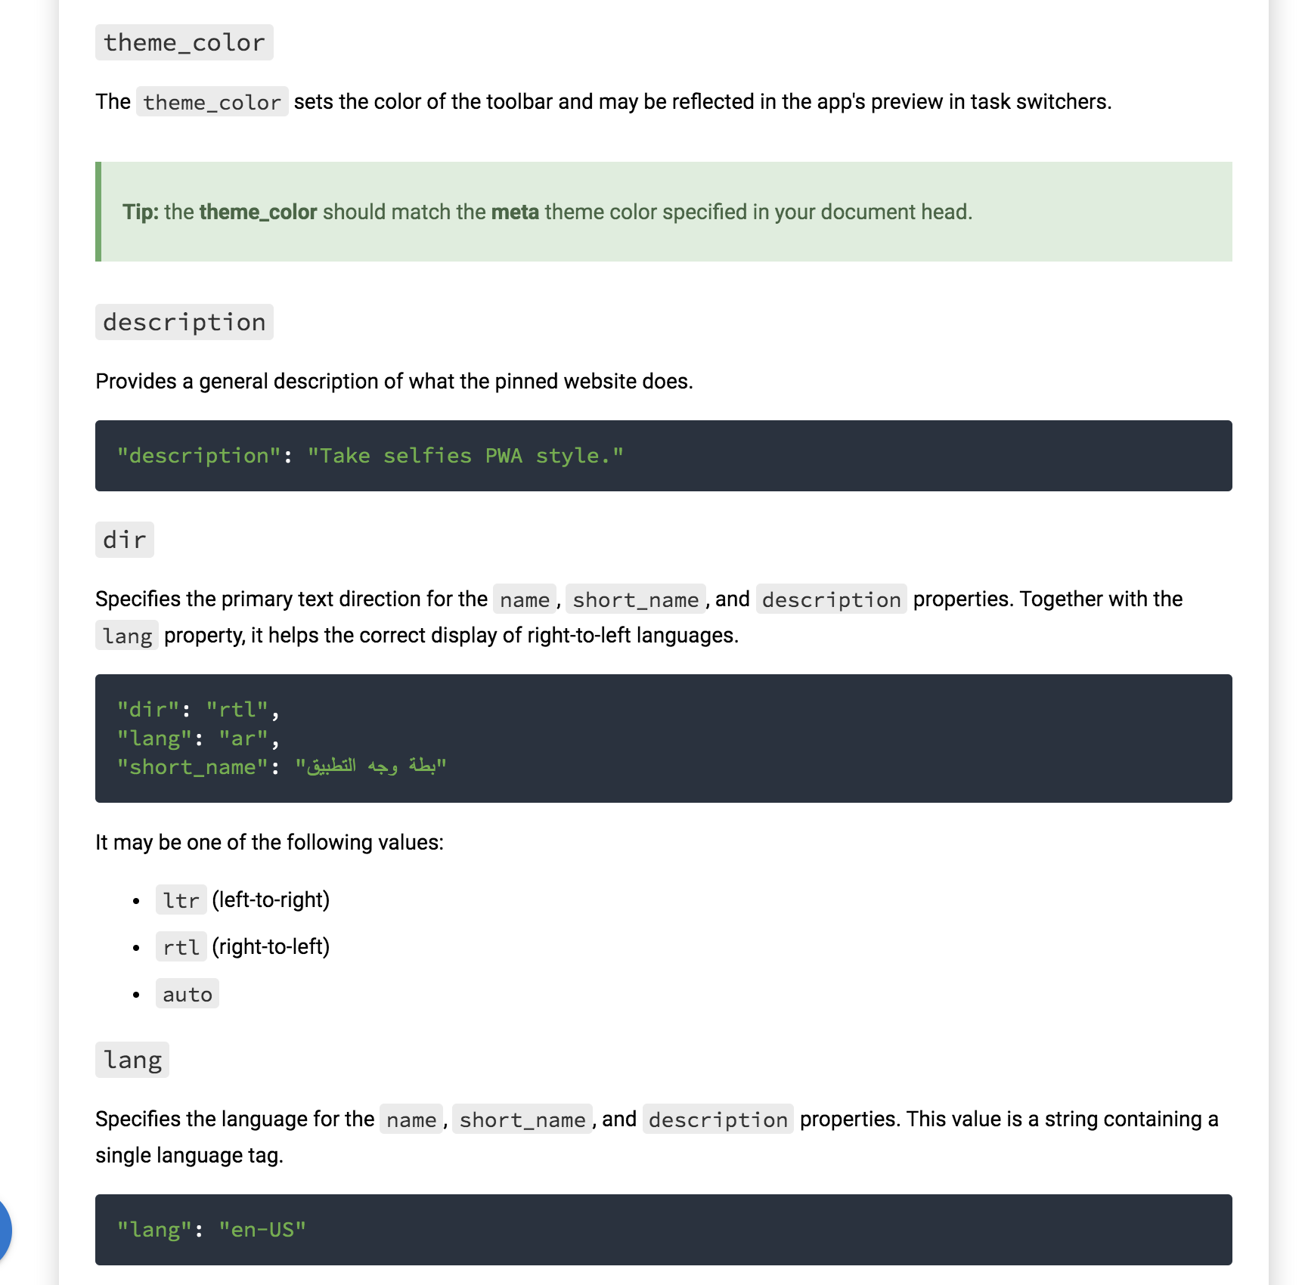

Slide 10
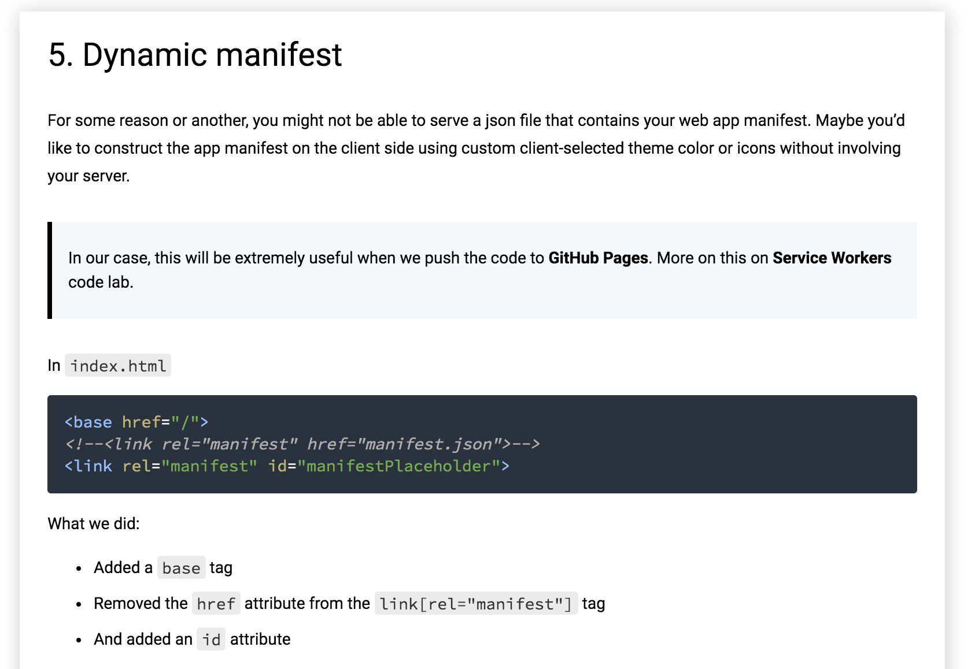

Slide 11
Add this in app.js
const manifest = { ... }; // Replace { ... } with the content of the manifest.json file
window.addEventListener('load', () => {
const base = document.querySelector('base');
let baseUrl = base && base.href || '';
if (!baseUrl.endsWith('/')) {
baseUrl = `${baseUrl}/`;
}
manifest['start_url'] = `${baseUrl}index.html`;
manifest.icons.forEach(icon => {
icon.src = `${baseUrl}${icon.src}`;
});
const stringManifest = JSON.stringify(manifest);
const blob = new Blob([stringManifest], {type: 'application/json'});
const manifestURL = URL.createObjectURL(blob);
document.querySelector('#manifestPlaceholder').setAttribute('href', manifestURL);
});

Slide 12
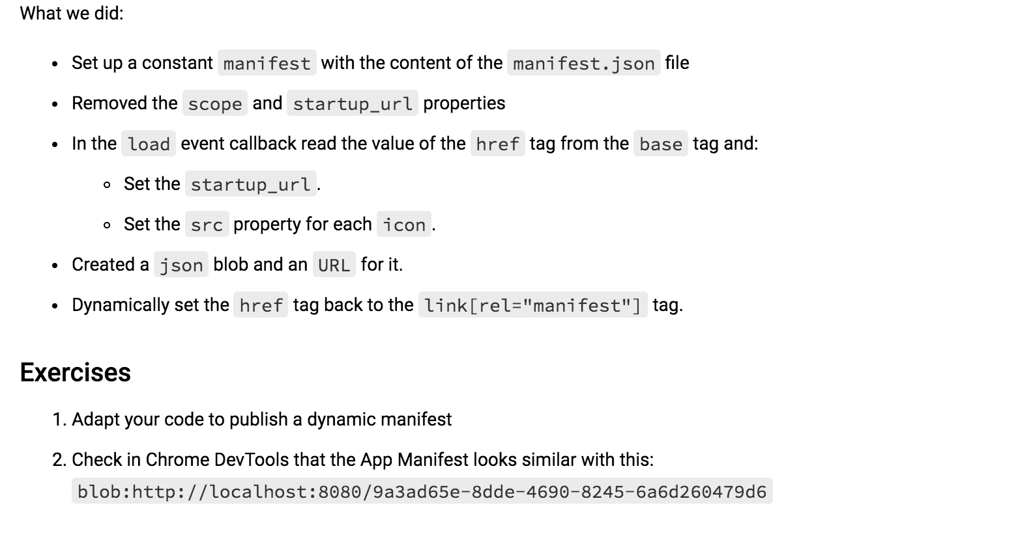

Slide 13
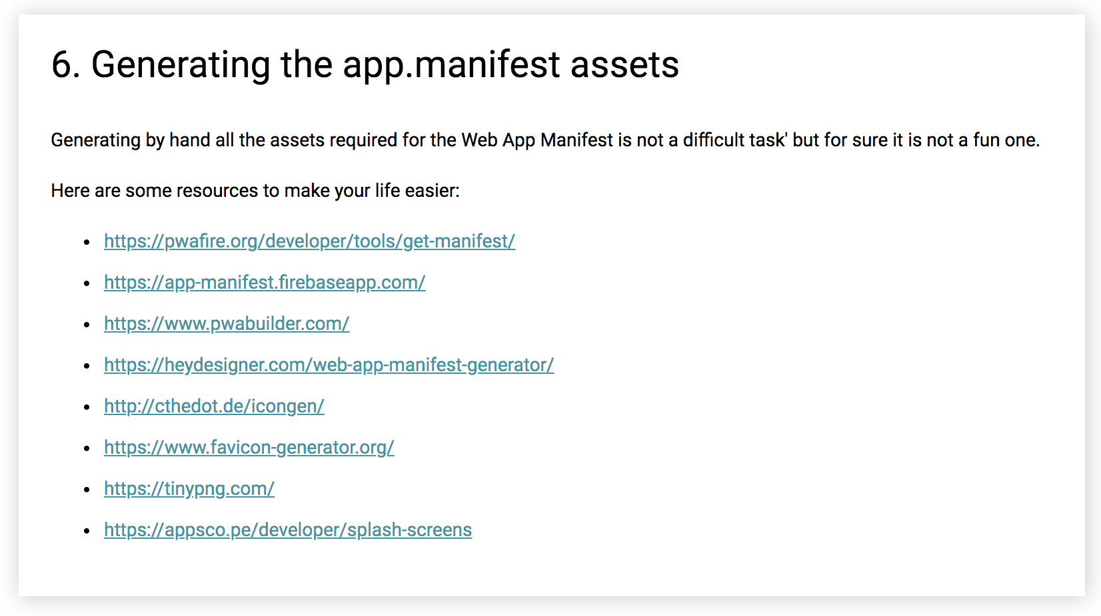

Slide 14
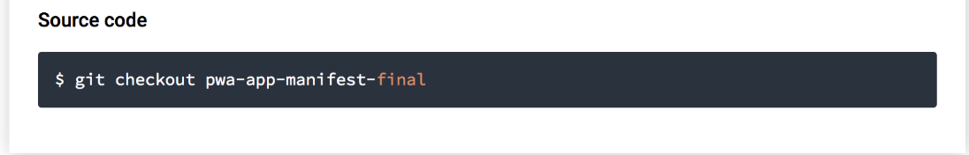
Solution

Slide 15
Introduction to
Service Workers

Slide 16
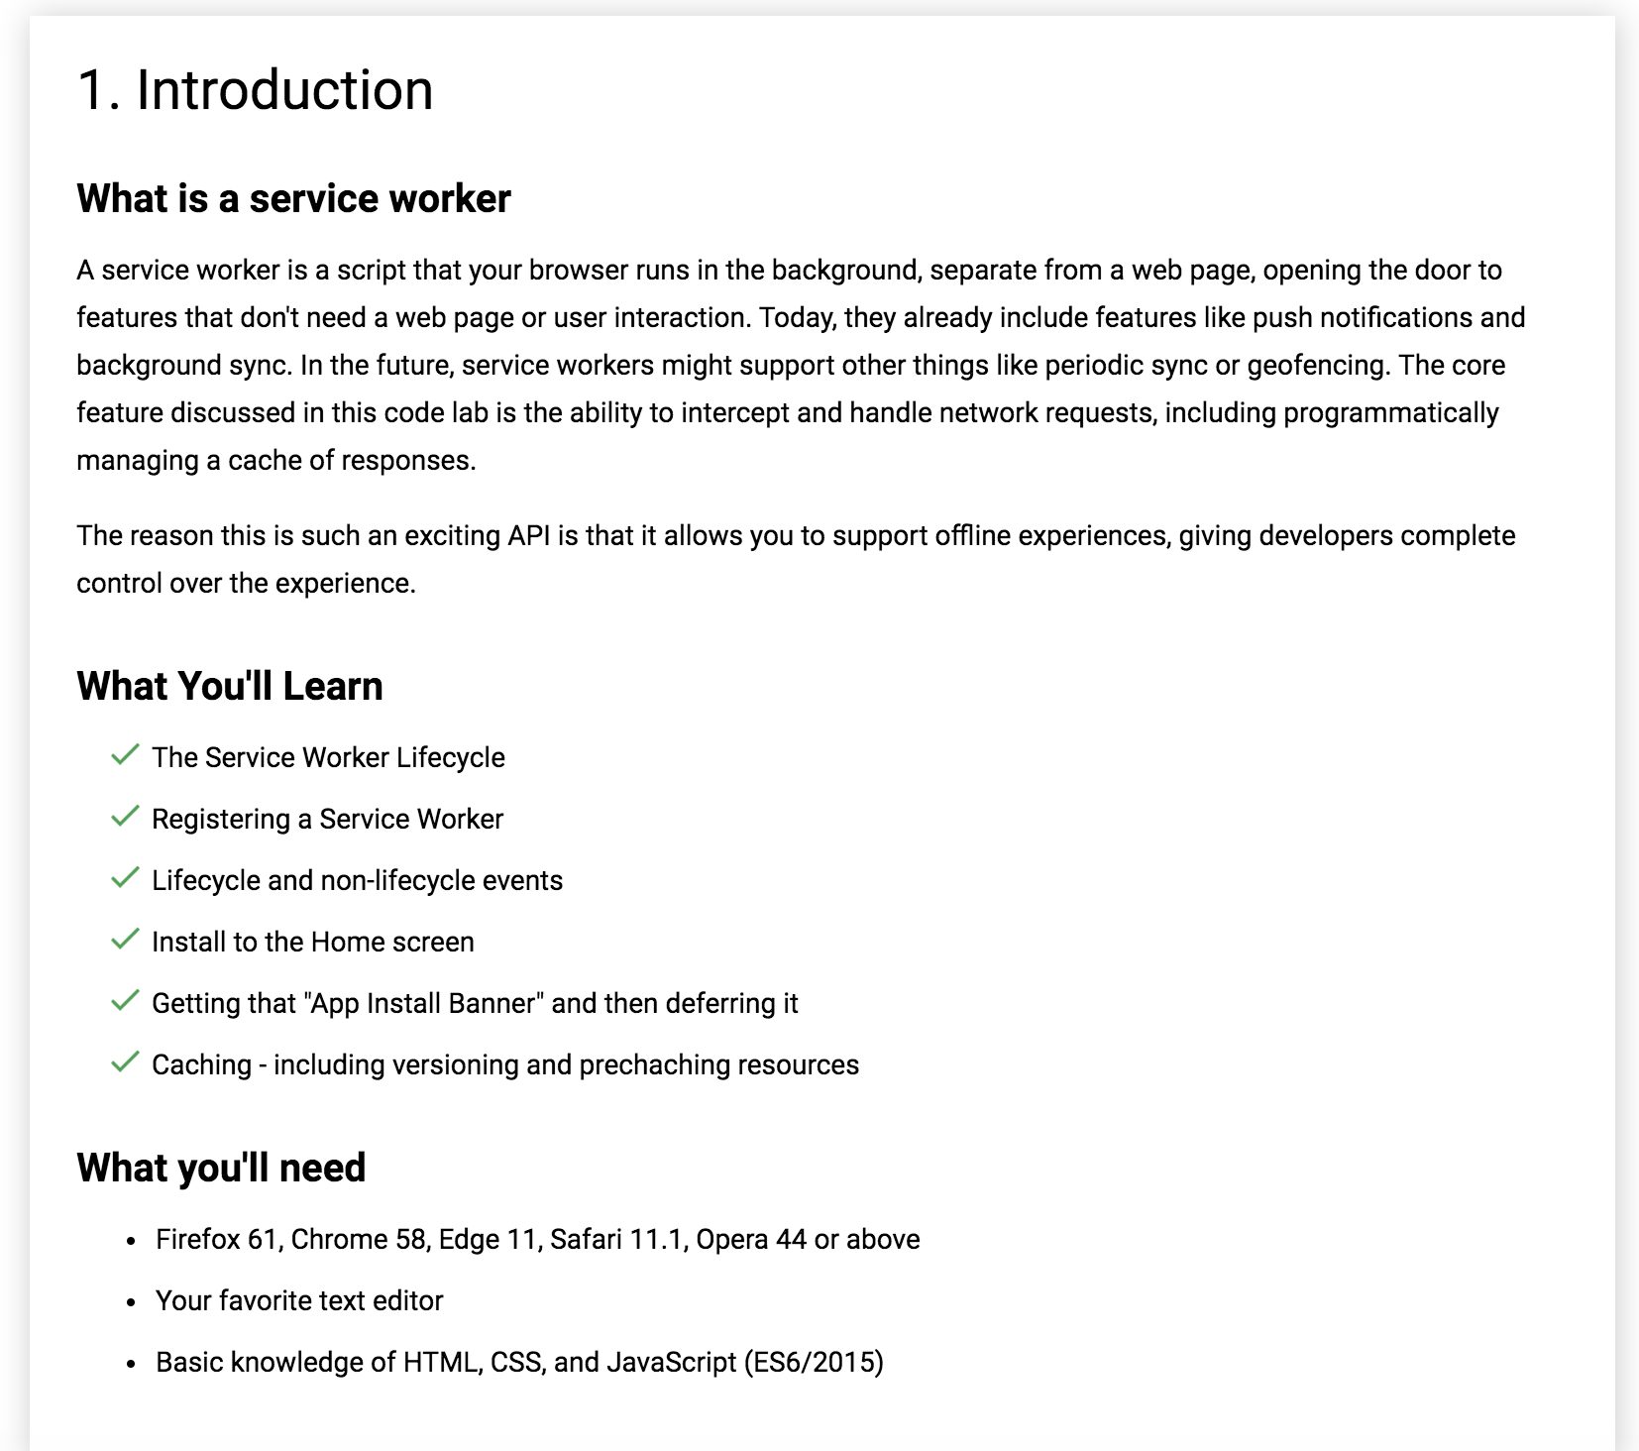

Slide 17
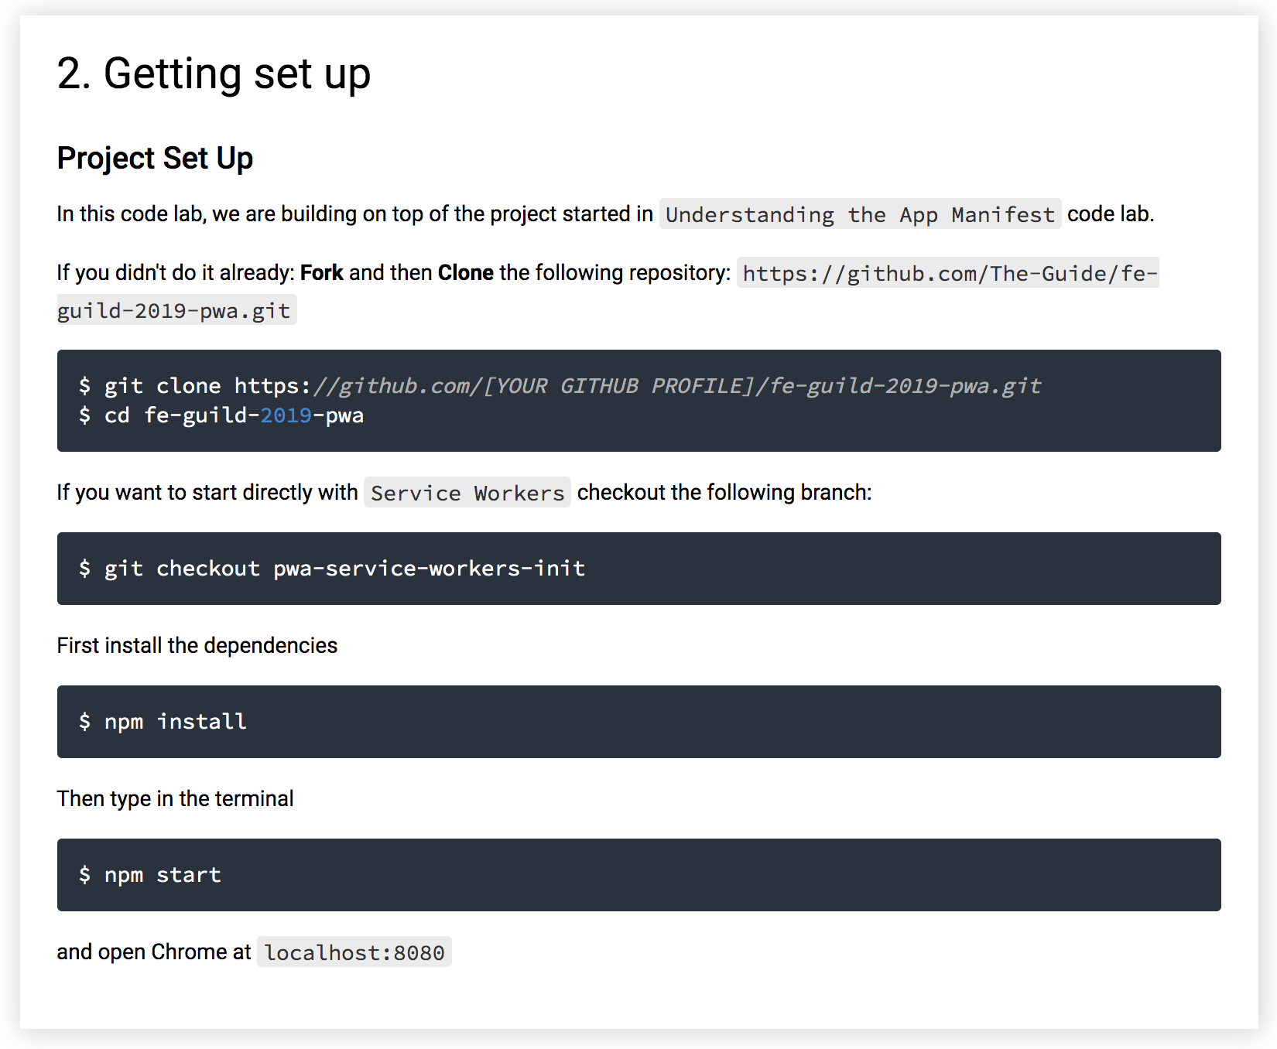

Slide 18
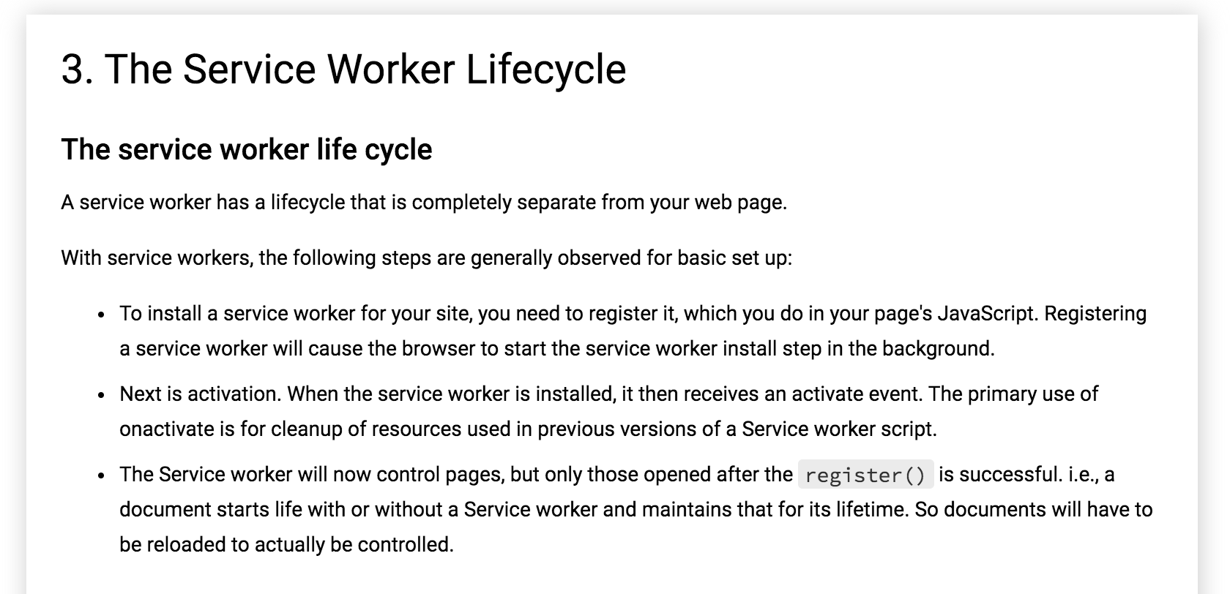

Slide 19
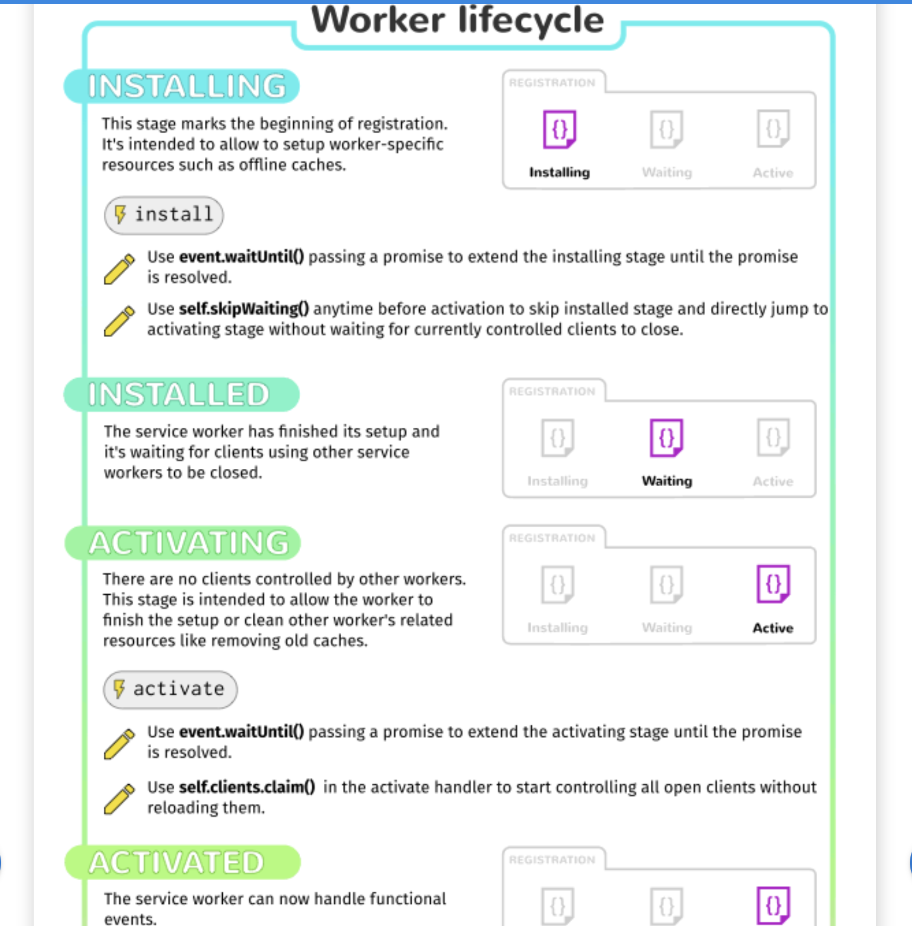

Slide 20
Register a Service Worker in sw.js
To install a service worker, you need to kick start the process by registering it on your page. This tells the browser where your service worker JavaScript file lives. Create a file named sw.js on the same level as index.html then in src/js/app.js:
window.addEventListener('load', () => {
// After the existing code
if ('serviceWorker' in navigator) {
navigator.serviceWorker.register(`${baseUrl}sw.js`)
.then( registration => {
// Registration was successful
console.log('ServiceWorker registration successful with scope: ', registration.scope);
})
.catch(err => {
// registration failed :(
console.log('ServiceWorker registration failed: ', err);
});
}
});

Slide 21
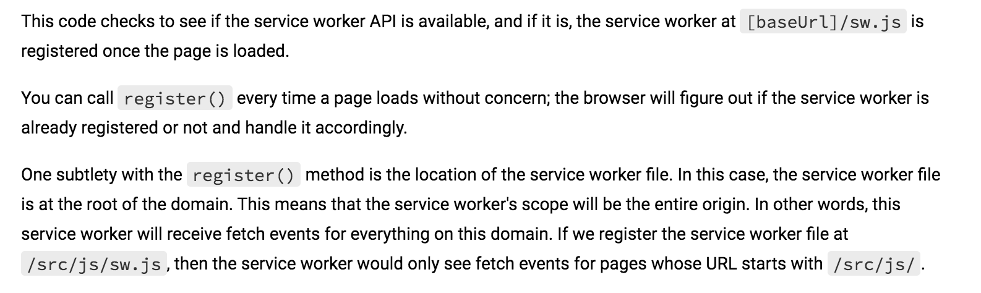

Slide 22
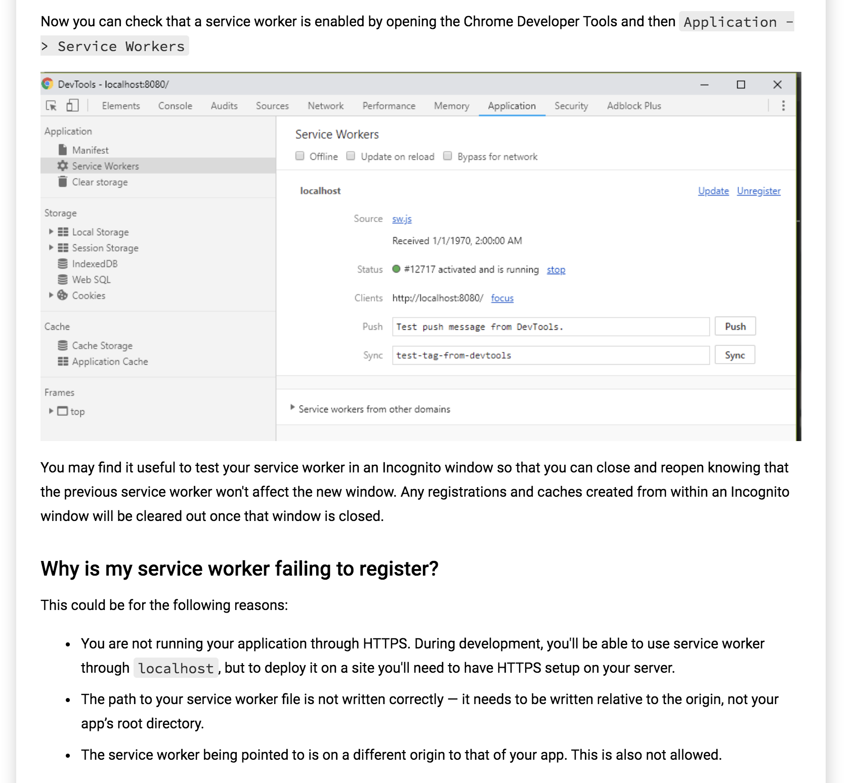

Slide 23


Slide 24
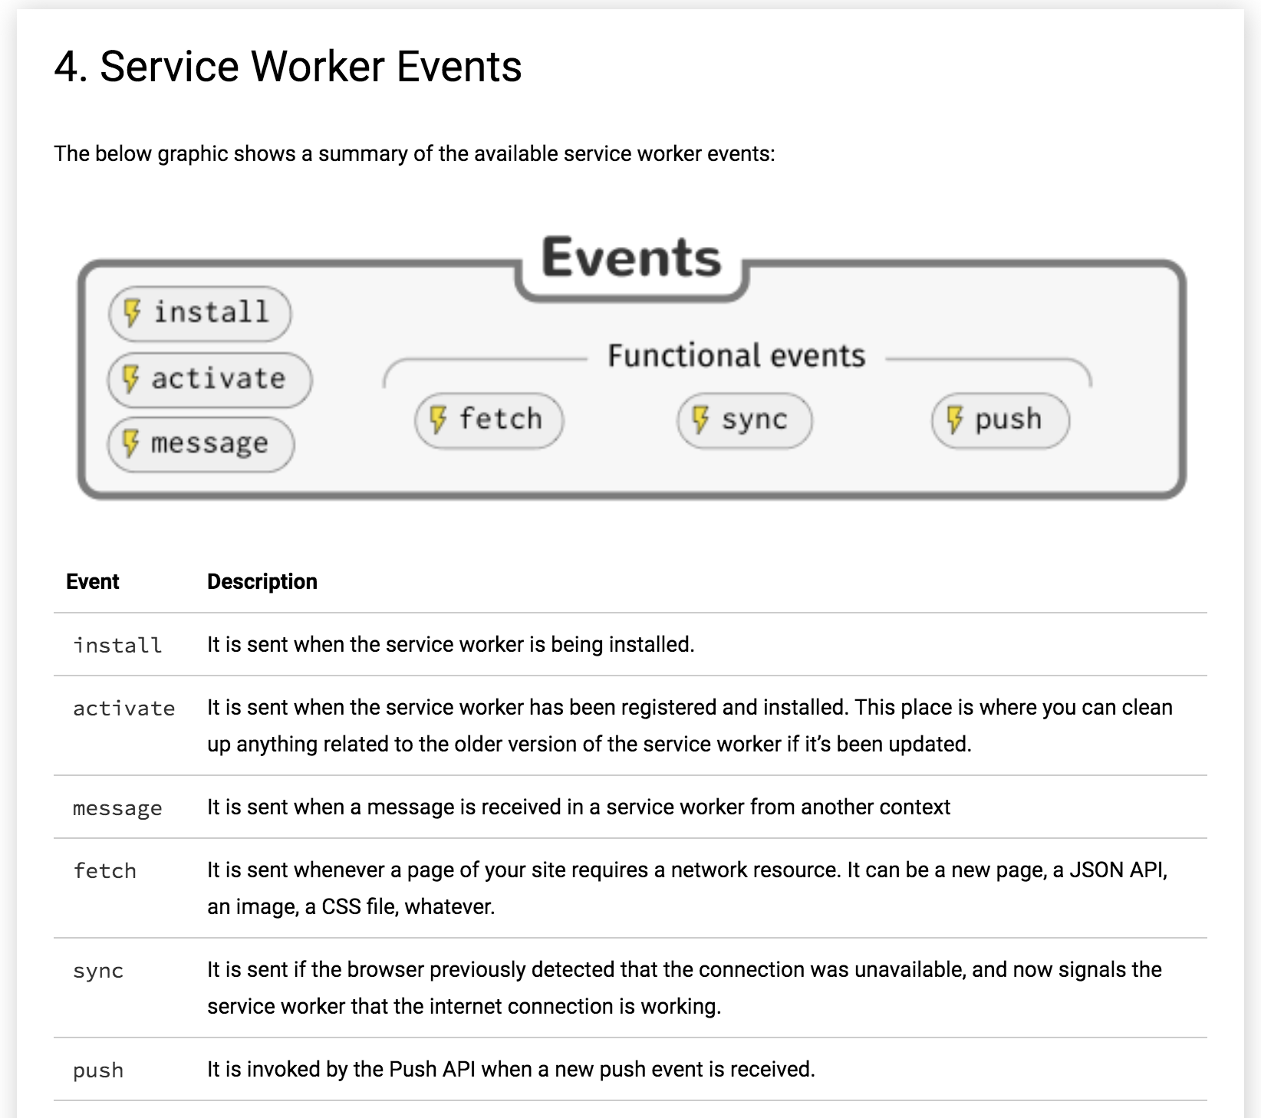

Slide 25
Add this in sw.js
Let's listen to the main lifecycle events install and activate
In sw.js
self.addEventListener('install', event => {
console.log('[Service Worker] Installing Service Worker ...', event);
event.waitUntil(self.skipWaiting());
});
self.addEventListener('activate', event => {
console.log('[Service Worker] Activating Service Worker ...', event);
return self.clients.claim();
});

Slide 26
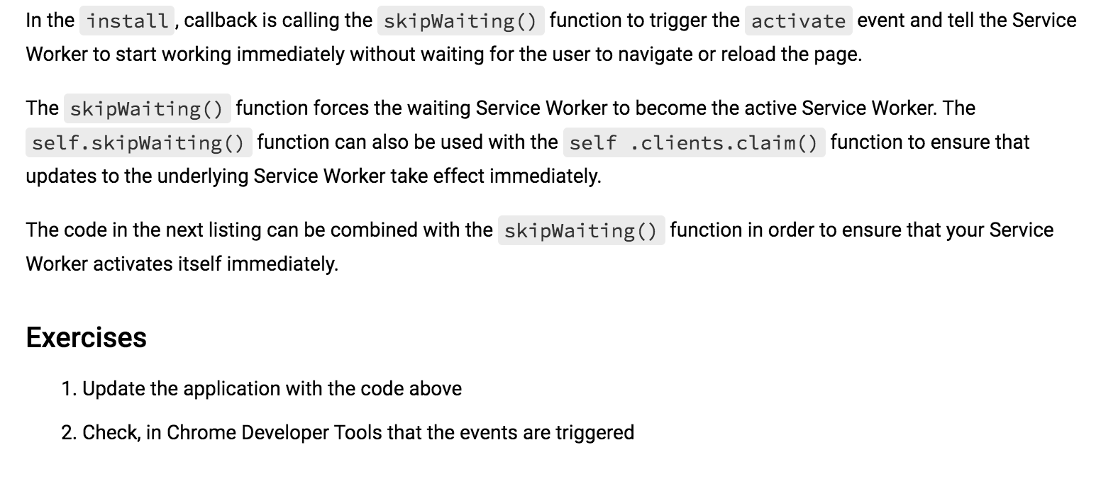

Slide 27
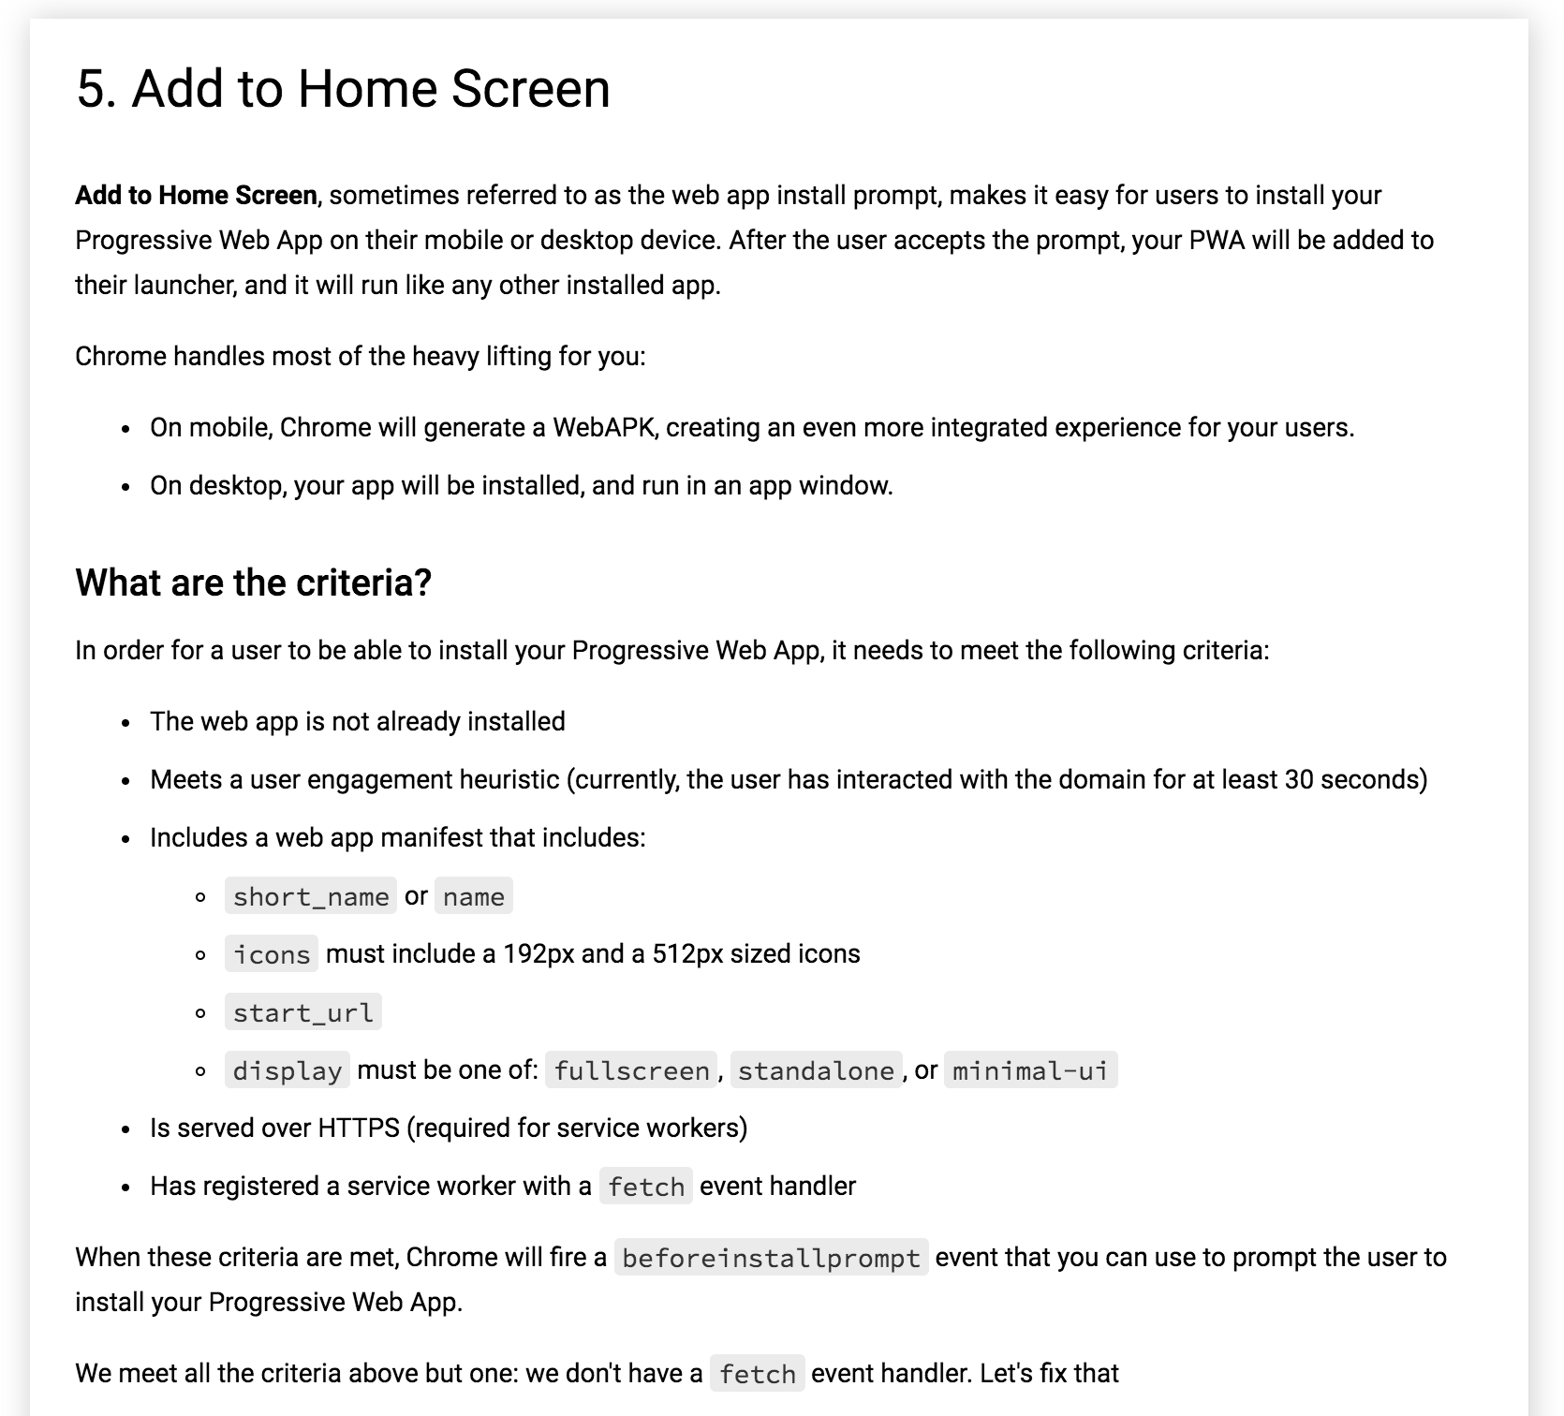

Slide 28
Add this in sw.js
self.addEventListener('fetch', event => {
console.log('[Service Worker] Fetching something ....', event);
// This fixes a weird bug in Chrome when you open the Developer Tools
if (event.request.cache === 'only-if-cached' && event.request.mode !== 'same-origin') {
return;
}
event.respondWith(fetch(event.request));
});

Slide 29
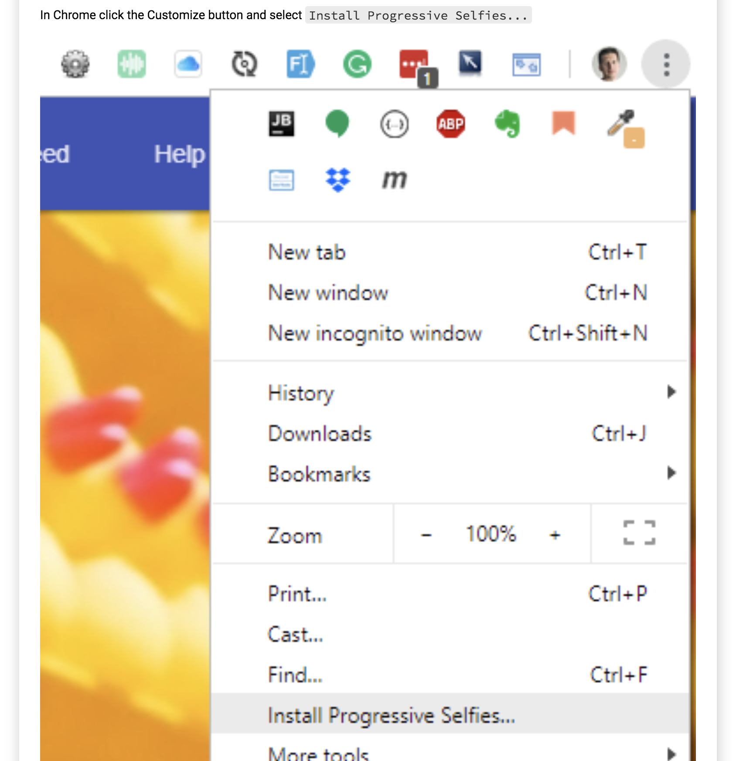

Slide 30
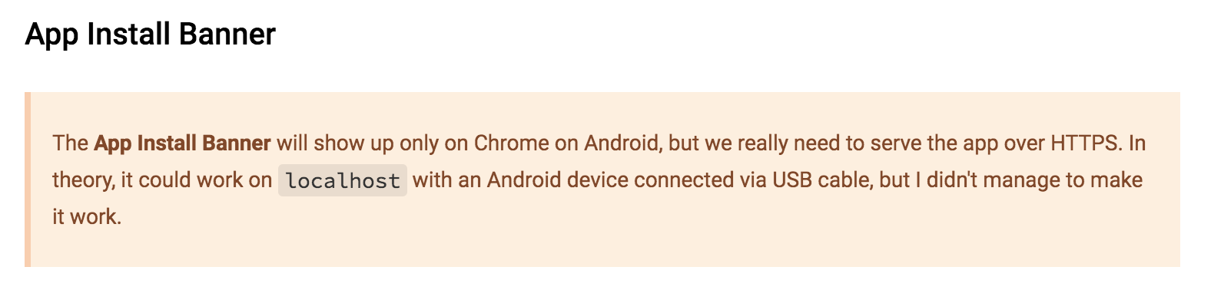

Slide 31
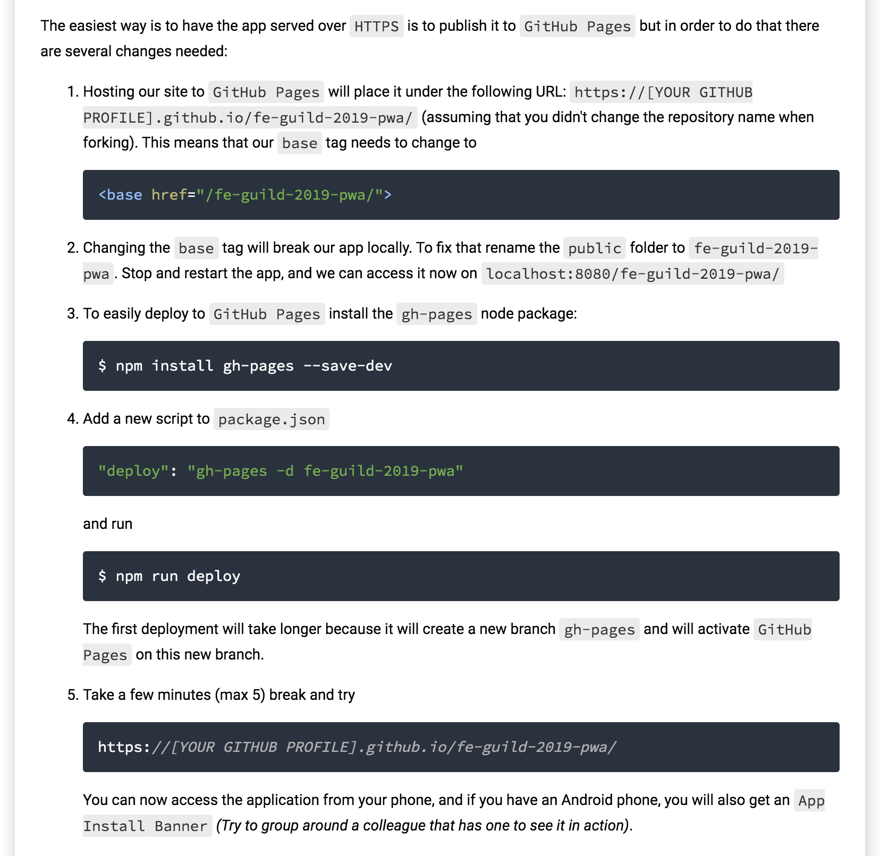
Optional:

Slide 32
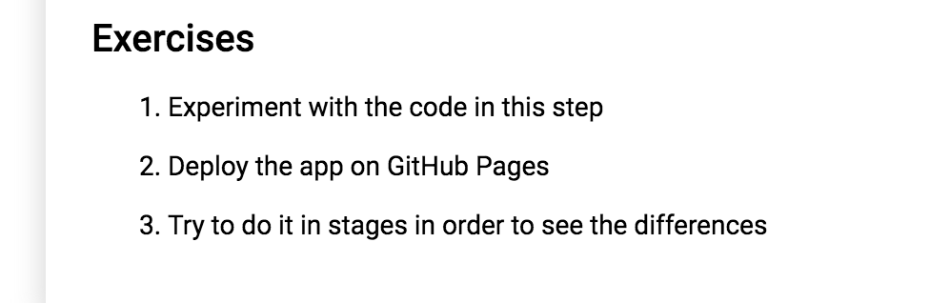

Slide 33
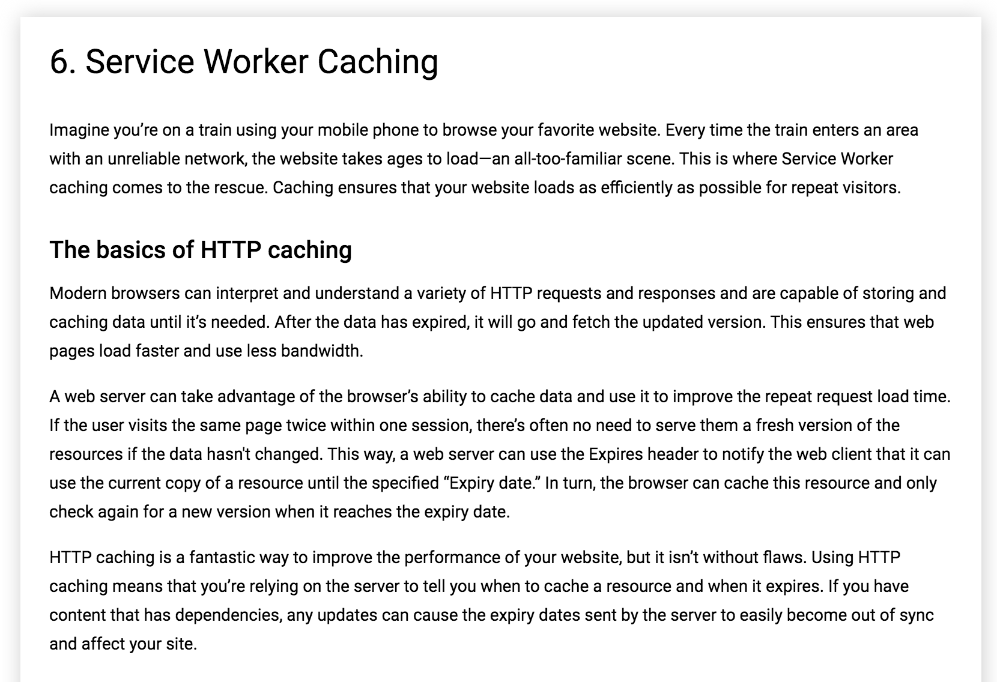

Slide 34
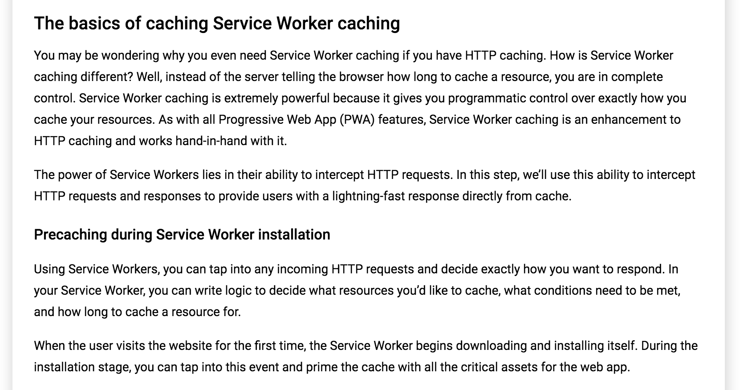

Slide 35
Add this in sw.js
const CACHE_STATIC_NAME = 'static';
const URLS_TO_PRECACHE = [
'/',
'index.html',
'src/js/app.js',
'src/js/feed.js',
'src/lib/material.min.js',
'src/lib/material.indigo-deep_orange.min.css',
'src/css/app.css',
'src/css/feed.css',
'src/images/main-image.jpg',
'https://fonts.googleapis.com/css?family=Roboto:400,700',
'https://fonts.googleapis.com/icon?family=Material+Icons',
// 'https://code.getmdl.io/1.3.0/material.indigo-deep_orange.min.css"'
];
self.addEventListener('install', event => {
console.log('[Service Worker] Installing Service Worker ...', event);
event.waitUntil(
caches.open(CACHE_STATIC_NAME)
.then(cache => {
console.log('[Service Worker] Precaching App Shell');
cache.addAll(URLS_TO_PRECACHE);
})
.then(() => {
console.log('[ServiceWorker] Skip waiting on install');
return self.skipWaiting();
})
);
});

Slide 36
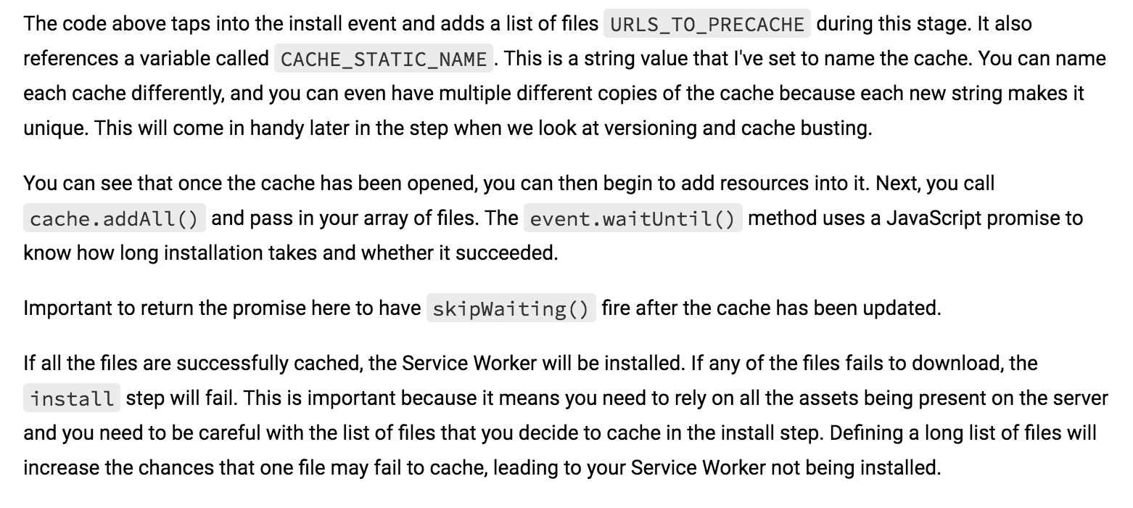

Slide 37
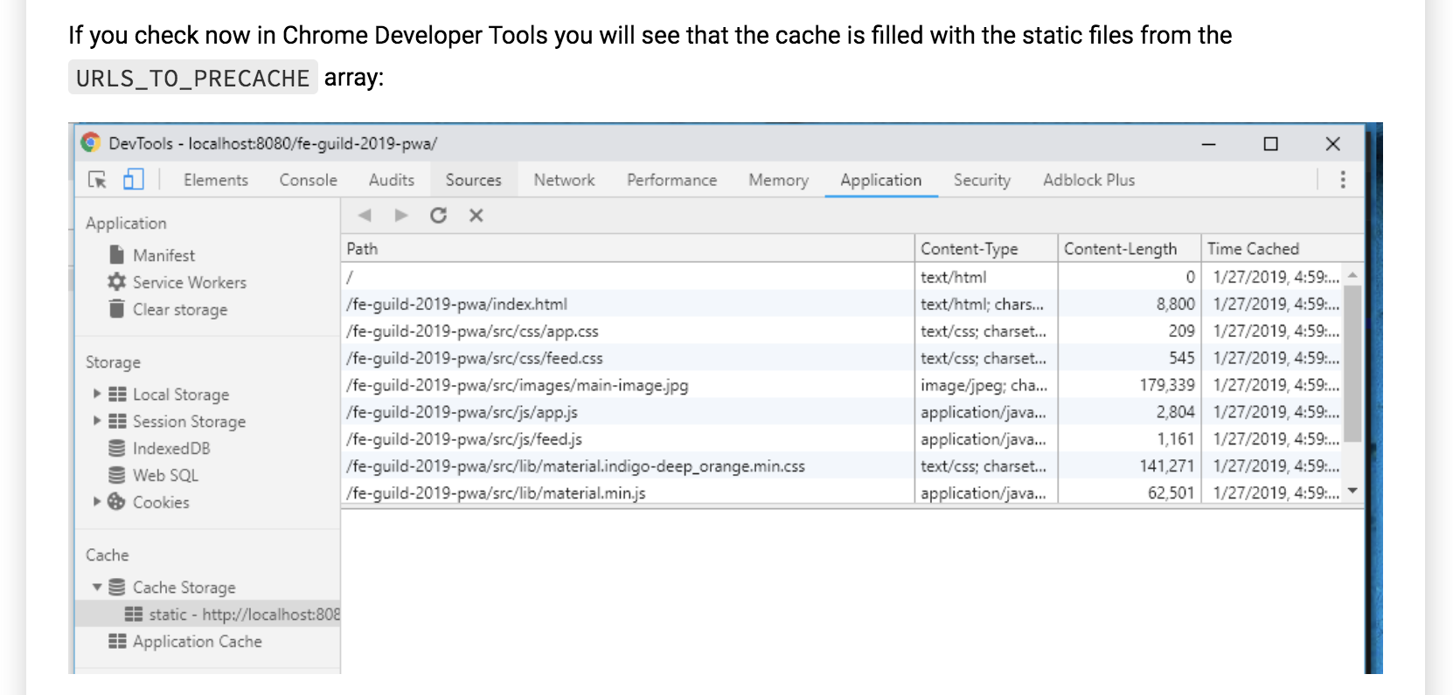

Slide 38
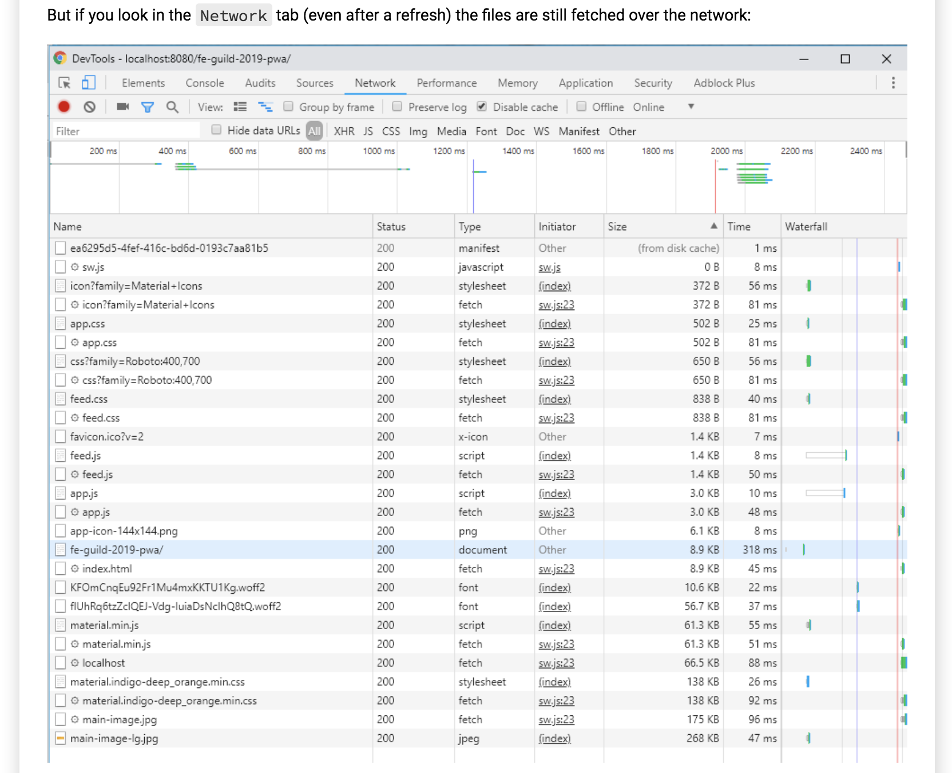

Slide 39
Add this in sw.js
The reason is that the cache is primed and ready to go, but we are not reading assets from it. In order to do that we need to add the code in the next listing to our Service Worker in order to start listening to the fetch event.
self.addEventListener('fetch', event => {
console.log('[Service Worker] Fetching something ....', event);
event.respondWith(
caches.match(event.request)
.then(response => {
if (response) {
console.log(response);
return response;
}
return fetch(event.request);
})
);
});
We are checking if the incoming URL matches anything that might exist in our current cache using the caches.match() function. If it does, return that cached resource, but if the resource doesn't exist in the cache, continue as normal and fetch the requested resource.

Slide 40
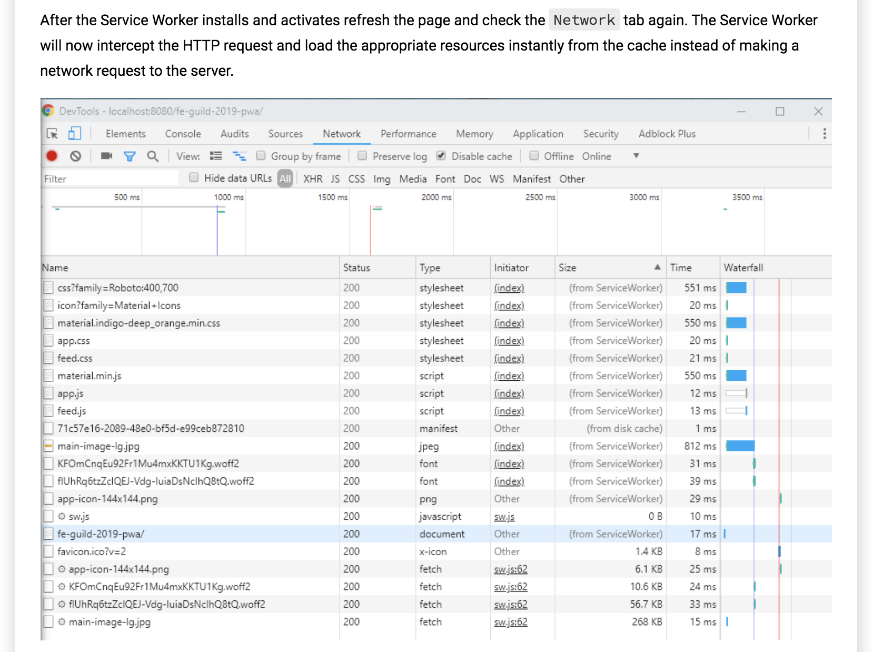

Slide 41
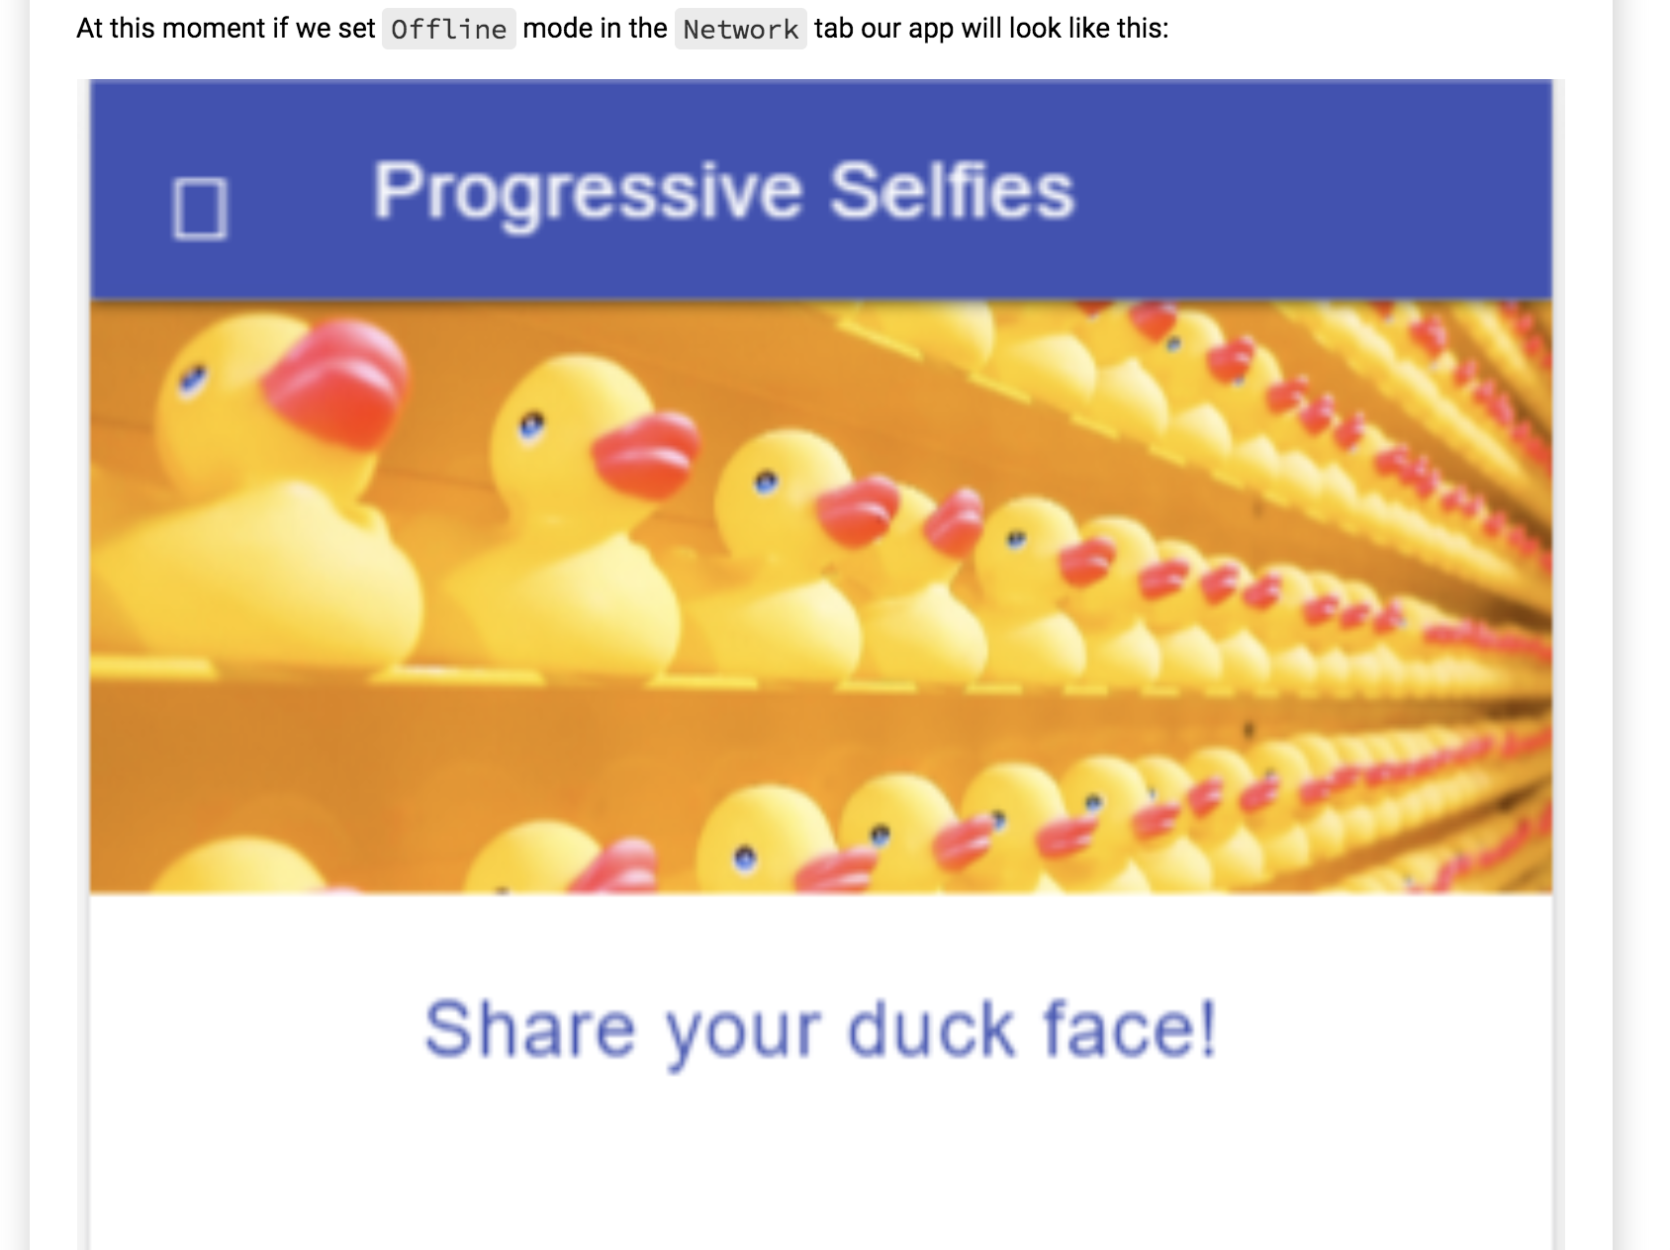

Slide 42
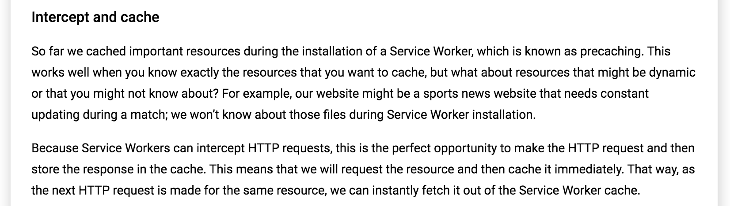

Slide 43
Add this in sw.js
// Add a new cache for dynamic content
const CACHE_DYNAMIC_NAME = 'dynamic';
self.addEventListener('fetch', event => {
console.log('[Service Worker] Fetching something ....', event);
event.respondWith(
caches.match(event.request)
.then(response => {
if (response) {
return response;
}
// Clone the request - a request is a stream and can be only consumed once
const requestToCache = event.request.clone();
// Try to make the original HTTP request as intended
return fetch(requestToCache)
.then(response => {
// If request fails or server responds with an error code, return that error immediately
if (!response || response.status !== 200) {
return response;
}
// Again clone the response because you need to add it into the cache and because it's used
// for the final return response
const responseToCache = response.clone();
caches.open(CACHE_DYNAMIC_NAME)
.then(cache => {
cache.put(requestToCache, responseToCache);
});
return response;
})
})
.catch(error => console.log('[Service Worker] Dynamic cache error.', error))
);
});
The code above caches the resource fetched from the network and returns it back to the page. If we reload the page, the resources cached in both caches will be matched.

Slide 44
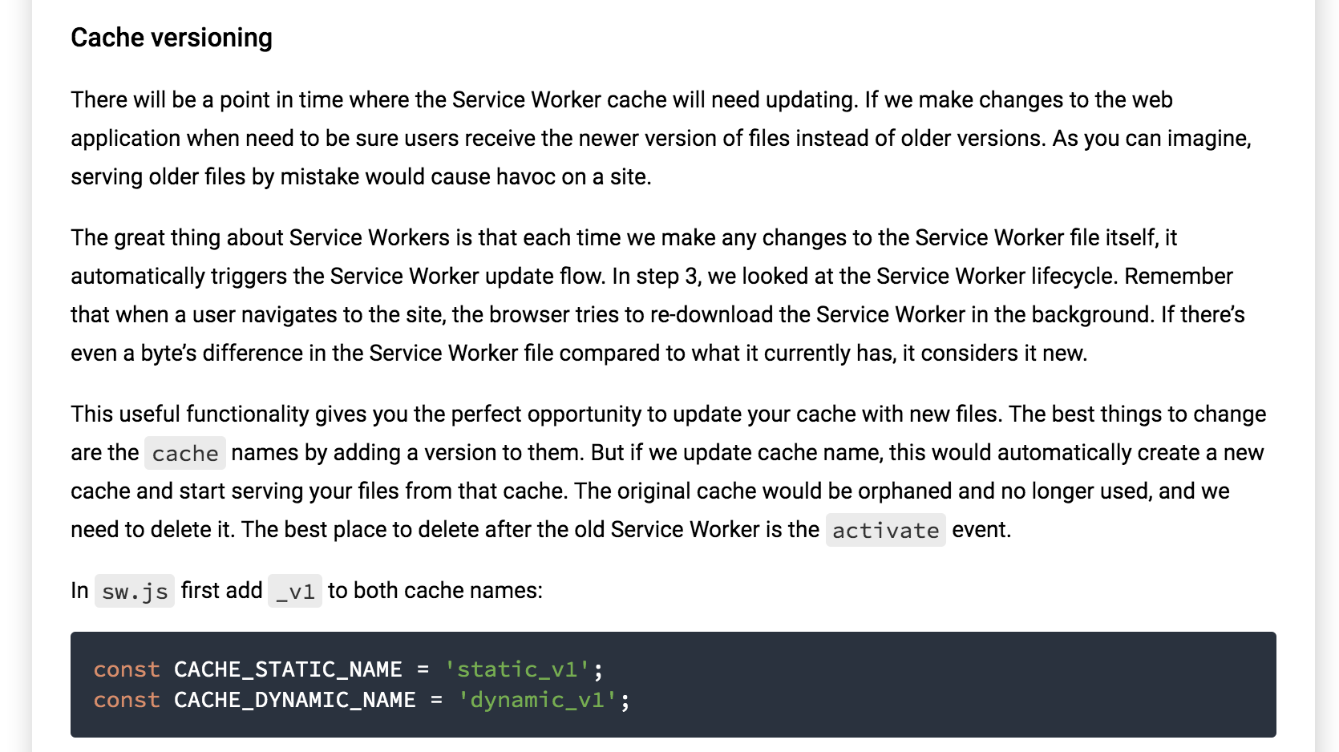

Slide 45
Add this in sw.js
self.addEventListener('activate', event => {
console.log('[Service Worker] Activating Service Worker ...', event);
event.waitUntil(
caches.keys()
.then(cacheNames => {
return Promise.all(cacheNames.map(cacheName => {
if (cacheName !== CACHE_STATIC_NAME && cacheName !== CACHE_DYNAMIC_NAME) {
console.log('[Service Worker] Removing old cache.', cacheName);
return caches.delete(cacheName);
}
}));
})
.then(() => {
console.log('[ServiceWorker] Claiming clients');
return self.clients.claim();
})
);
});

Slide 46
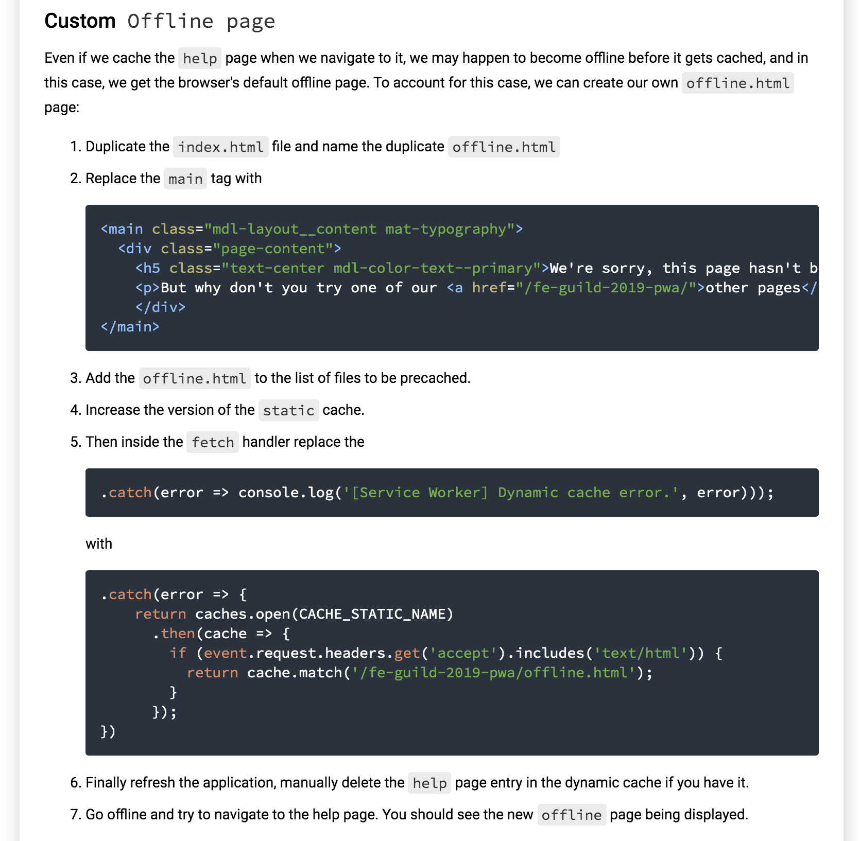

Slide 47
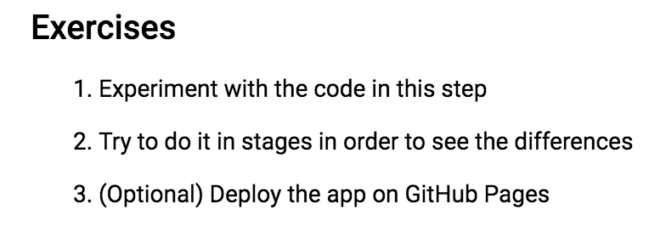

Slide 48
Solution

